Slide 1

PowerShell & Microsoft Graph
from Scratch
Xavier Clinquart
&
Merlijn Van Waeyenberghe

Slide 2


Our sponsors

Slide 3


Xavier Clinquart
Merlijn Van Waeyenberghe
Consultant @ Axxes
Xavier@bepug.be
Consultant @ OB-V-US
Merlijn@bepug.be

Slide 4

Connect to MS Graph
Invoke-WebRequest
Invoke-RESTMethod
Microsoft Graph PowerShell SDK

Slide 5
Invoke-RESTMethod
Why?
Less dependencies
Not everything possible in SDK
Stability
Portability
Notes:
SDK is not always up to date with the latest additions or some verry specific attributes
Using this you are only dependent on API changes that are a lot more uncommon then SDK changes.
You can also use this in Power Automate while you can not use the SDK here

Slide 6

Authentication
Device login
Certificate
Client secret
User login
Azure managed identities
Notes:
Swap to tenant to view these options

Slide 7
Permissions
https://learn.microsoft.com/en-us/graph/permissions-reference#code-try-0
Notes:
Go over the permissions options on the site
Example Sites : https://learn.microsoft.com/en-us/graph/api/site-list?view=graph-rest-1.0&tabs=http

Slide 8
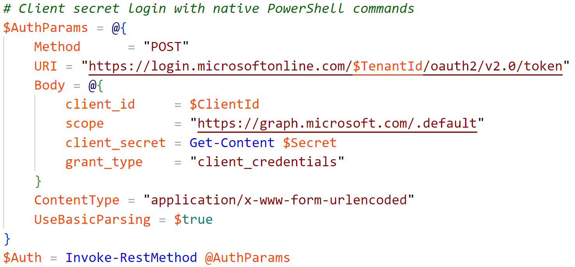
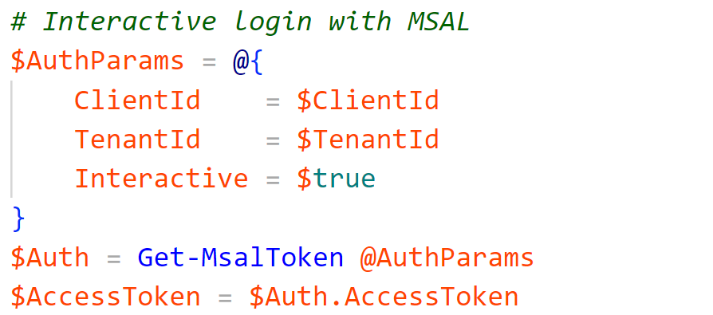
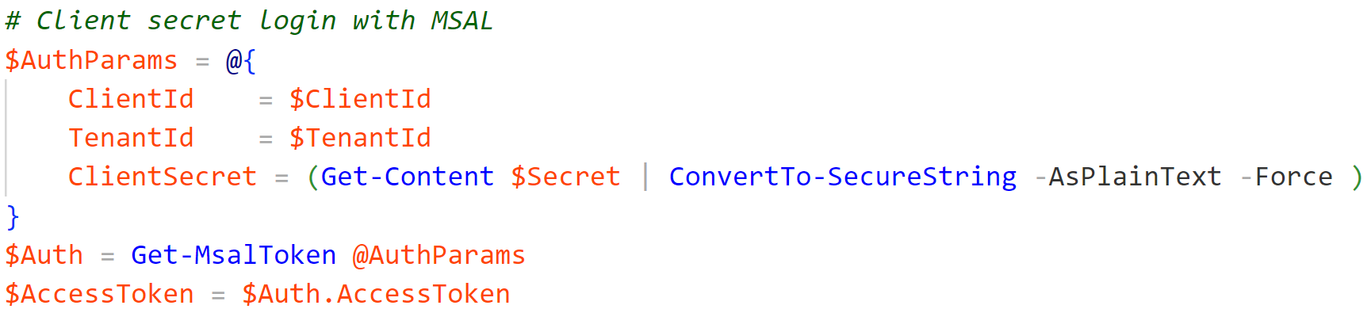
Building the API call
Notes:
Fully native with client secret
Client secret using the MSAL module
With user interaction MSAL module

Slide 9
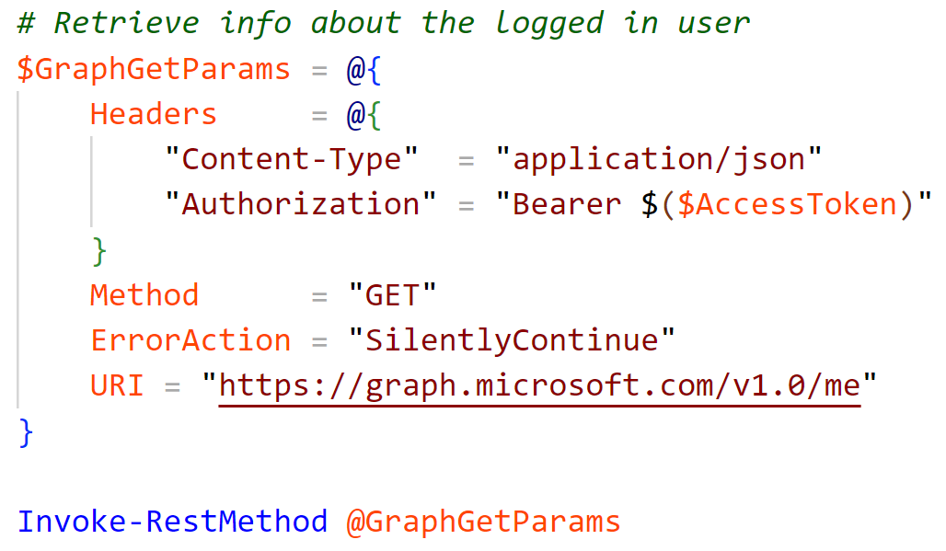
Building the API call
Notes:
Buildup with the Headers first -> Working in JSON
The bearer has the accestoken previously received
Methods:
GET - Read data from a resource.
POST - Create a new resource or perform an action.
PATCH -Update a resource with new values.
PUT- Replace a resource with a new one.
DELETE - Remove a resource.

Slide 10
Building the API call
Version
1.0
beta
Resource
User
Me
...
Query-parameters
OData Query
Notes:
GET
Read data from a resource.
POST
Create a new resource, or perform an action.
PATCH
Update a resource with new values.
PUT
Replace a resource with a new one.
DELETE
Remove a resource.

Slide 11
Finding information
Graph explorer
Graph REST API reference
Odata query

Slide 12


Slide 13


